Slide 1

SEMINAR CÁC VẤN ĐỀ HIỆN ĐẠI CỦA CÔNG NGHỆ PHẦN MỀM
KHOA CÔNG NGHỆ PHẦN MỀM
HCM-2021

Slide 2
NỘI DUNG
Giới thiệu
Cơ sở toán học
Tính toán lượng tử
Máy tính lượng tử
Niels Bohr

Slide 3
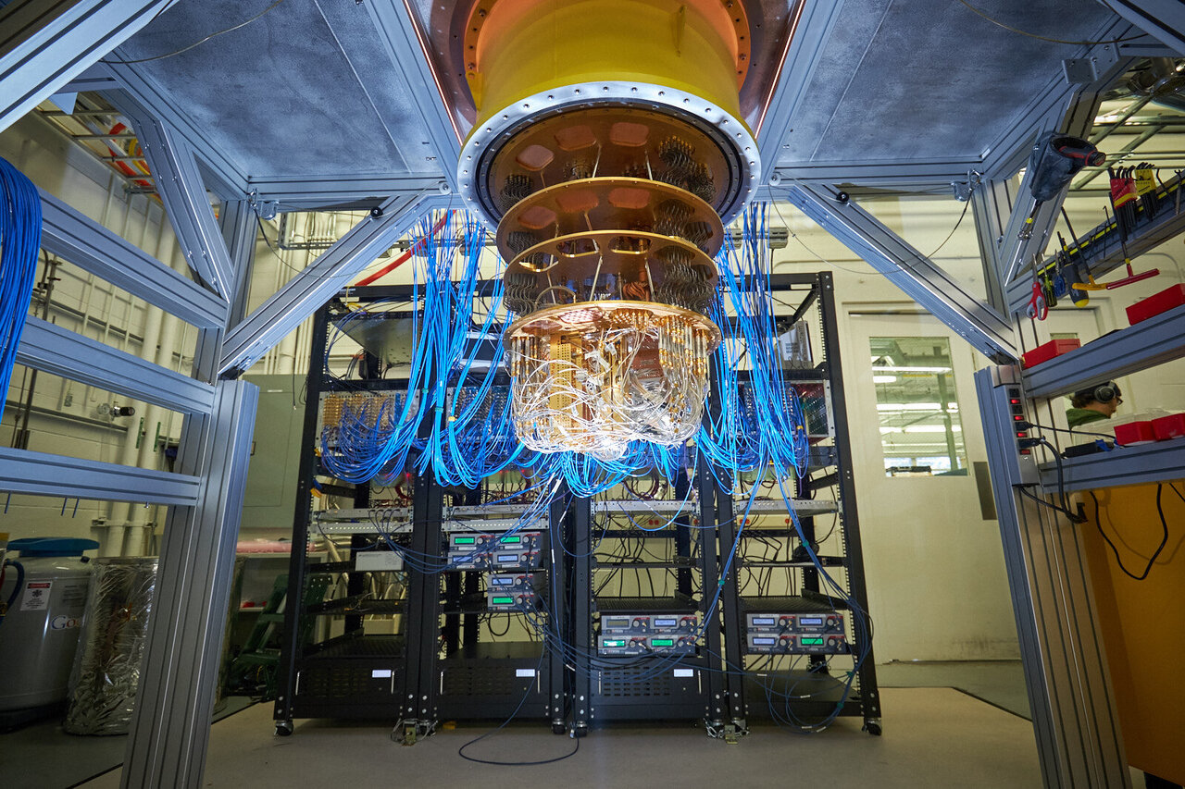
Giới thiệu
Máy tính lượng tử

Slide 4
Giới thiệu
Introduction and History
Data Representation
Operations on Data
Shor’s Algorithm
Conclusion and Open Questions

Slide 5
Introduction
What is a quantum computer?
A quantum computer is a machine that performs calculations based on the laws of quantum mechanics, which is the behavior of particles at the sub-atomic level.

Slide 6
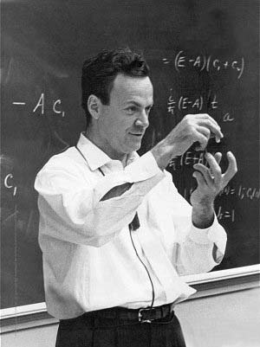
Introduction
“I think I can safely say that nobody understands quantum mechanics” - Feynman
1982 - Feynman proposed the idea of creating machines based on the laws of quantum mechanics instead of the laws of classical physics.
1985 - David Deutsch developed the quantum turing machine, showing that quantum circuits are universal.
1994 - Peter Shor came up with a quantum algorithm to factor very large numbers in polynomial time.
1997 - Lov Grover develops a quantum search algorithm with O(√N) complexity

Slide 7
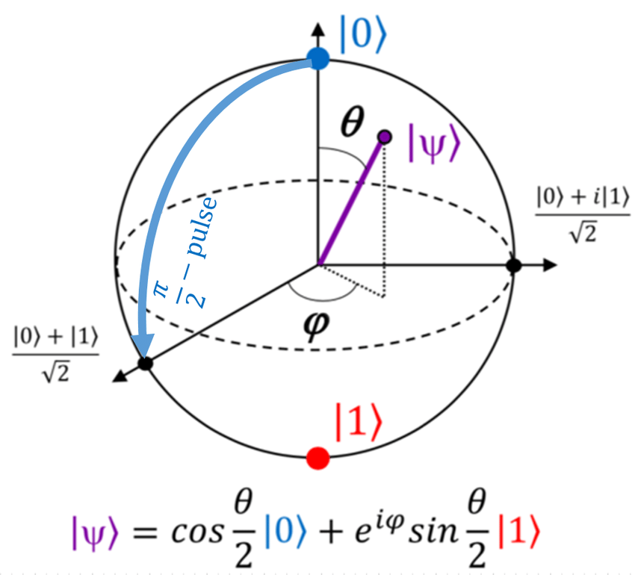
Mức lượng tử

Slide 8
Overview
Introduction and History
Data Representation
Operations on Data
Shor’s Algorithm
Conclusion and Open Questions

Slide 9
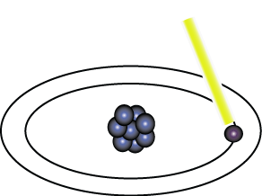
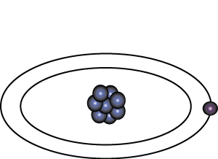
Representation of Data - Qubits
A bit of data is represented by a single atom that is in one of two states denoted by |0> and |1>. A single bit of this form is known as a qubit
A physical implementation of a qubit could use the two energy levels of an atom. An excited state representing |1> and a ground state representing |0>.
Light pulse of frequency λ for time interval t
Excited State
Ground State
Nucleus
Electron
State |0>
State |1>

Slide 10
Representation of Data - Superposition
A single qubit can be forced into a superposition of the two states denoted by the addition of the state vectors:
|ψ> = α |0> + α |1>
Where α and α are complex numbers and |α | + | α | = 1
1
2
2
2
1
2
1
2
A qubit in superposition is in both of the states |1> and |0 at the same time

Slide 11
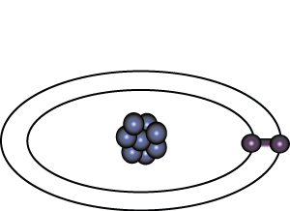
Representation of Data - Superposition
Light pulse of frequency λ for time interval t/2
State |0>
State |0> + |1>
Consider a 3 bit qubit register. An equally weighted superposition of all possible states would be denoted by:
|ψ> = |000> + |001> + . . . + |111>
1
1
1
√8
√8
√8

Slide 12
Data Retrieval
In general, an n qubit register can represent the numbers 0 through 2^n-1 simultaneously.
Sound too good to be true?…It is!
If we attempt to retrieve the values represented within a superposition, the superposition randomly collapses to represent just one of the original values.
In our equation: |ψ> = α |0> + α |1> , α represents the probability of the superposition collapsing to |0>. The α’s are called probability amplitudes. In a balanced superposition, α = 1/√2 where n is the number of qubits.
1
2
1
n

Slide 13
Relationships among data - Entanglement
Entanglement is the ability of quantum systems to exhibit correlations between states within a superposition.
Imagine two qubits, each in the state |0> + |1> (a superposition of the 0 and 1.) We can entangle the two qubits such that the measurement of one qubit is always correlated to the measurement of the other qubit.

Slide 14
Overview
Introduction and History
Data Representation
Operations on Data
Shor’s Algorithm
Conclusion and Open Questions

Slide 15
Operations on Qubits - Reversible Logic
Due to the nature of quantum physics, the destruction of information in a gate will cause heat to be evolved which can destroy the superposition of qubits.
Ex.
The AND Gate
Input
Output
In these 3 cases, information is being destroyed
A | B | C
0 | 0 | 0
0 | 1 | 0
1 | 0 | 0
1 | 1 | 1
A
C
B
This type of gate cannot be used. We must use Quantum Gates.

Slide 16
Quantum Gates
Quantum Gates are similar to classical gates, but do not have a degenerate output. i.e. their original input state can be derived from their output state, uniquely. They must be reversible.
This means that a deterministic computation can be performed on a quantum computer only if it is reversible. Luckily, it has been shown that any deterministic computation can be made reversible.(Charles Bennet, 1973)

Slide 17
Quantum Gates - Hadamard
Simplest gate involves one qubit and is called a Hadamard Gate (also known as a square-root of NOT gate.) Used to put qubits into superposition.
H
H
State |0>
State |0> + |1>
State |1>
Note: Two Hadamard gates used in succession can be used as a NOT gate

Slide 18
Quantum Gates - Controlled NOT
A gate which operates on two qubits is called a Controlled-NOT (CN) Gate. If the bit on the control line is 1, invert the bit on the target line.
Input
Output
A - Target
A’
A | B | A’ | B’
0 | 0 | 0 | 0
0 | 1 | 1 | 1
1 | 0 | 1 | 0
1 | 1 | 0 | 1
B - Control
B’
Note: The CN gate has a similar behavior to the XOR gate with some extra information to make it reversible.

Slide 19
Example Operation - Multiplication By 2
We can build a reversible logic circuit to calculate multiplication by 2 using CN gates arranged in the following manner:
Input
Output
Carry Bit | Ones Bit | Carry Bit | Ones Bit
0 | 0 | 0 | 0
0 | 1 | 1 | 0
0
Carry Bit
H
Ones Bit

Slide 20
Quantum Gates - Controlled Controlled NOT (CCN)
A gate which operates on three qubits is called a Controlled Controlled NOT (CCN) Gate. Iff the bits on both of the control lines is 1,then the target bit is inverted.
Input
Output
A | B | C | A’ | B’ | C’
0 | 0 | 0 | 0 | 0 | 0
0 | 0 | 1 | 0 | 0 | 1
0 | 1 | 0 | 0 | 1 | 0
0 | 1 | 1 | 1 | 1 | 1
1 | 0 | 0 | 1 | 0 | 0
1 | 0 | 1 | 1 | 0 | 1
1 | 1 | 0 | 1 | 1 | 0
1 | 1 | 1 | 0 | 1 | 1
A - Target
A’
B - Control 1
B’
C - Control 2
C’

Slide 21
A Universal Quantum Computer
The CCN gate has been shown to be a universal reversible logic gate as it can be used as a NAND gate.
A - Target
A’
Input
Output
A | B | C | A’ | B’ | C’
0 | 0 | 0 | 0 | 0 | 0
0 | 0 | 1 | 0 | 0 | 1
0 | 1 | 0 | 0 | 1 | 0
0 | 1 | 1 | 1 | 1 | 1
1 | 0 | 0 | 1 | 0 | 0
1 | 0 | 1 | 1 | 0 | 1
1 | 1 | 0 | 1 | 1 | 0
1 | 1 | 1 | 0 | 1 | 1
B - Control 1
B’
C - Control 2
C’
When our target input is 1, our target output is a result of a NAND of B and C.

Slide 22
Overview
Introduction and History
Data Representation
Operations on Data
Shor’s Algorithm
Conclusion and Open Questions

Slide 23
Shor’s Algorithm
Shor’s algorithm shows (in principle,) that a quantum computer is capable of factoring very large numbers in polynomial time.
The algorithm is dependant on
Modular Arithmetic
Quantum Parallelism
Quantum Fourier Transform

Slide 24
Shor’s Algorithm - Periodicity
An important result from Number Theory:
F(a) = x mod N is a periodic function
a
Choose N = 15 and x = 7 and we get the following:
0
7 mod 15 = 1
7 mod 15 = 7
7 mod 15 = 4
7 mod 15 = 13
7 mod 15 = 1
1
2
3
4
.
.
.

Slide 25
Shor’s Algorithm - In Depth Analysis
To Factor an odd integer N (Let’s choose 15) :
Choose an integer q such that N < q < 2N let’s pick 256
Choose a random integer x such that GCD(x, N) = 1 let’s pick 7
Create two quantum registers (these registers must also be entangled so that the collapse of the input register corresponds to the collapse of the output register)
Input register: must contain enough qubits to represent numbers as large as q-1. up to 255, so we need 8 qubits
Output register: must contain enough qubits to represent numbers as large as N-1. up to 14, so we need 4 qubits
2
2

Slide 26
Shor’s Algorithm - Preparing Data
Load the input register with an equally weighted superposition of all integers from 0 to q-1. 0 to 255
Load the output register with all zeros.
The total state of the system at this point will be:
1
255
∑ |a, 000>
√256
a=0
Note: the comma here denotes that the registers are entangled
Input Register
Output Register

Slide 27
Shor’s Algorithm - Modular Arithmetic
a
Apply the transformation x mod N to each number in the input register, storing the result of each computation in the output register.
Note that we are using decimal numbers here only for simplicity.
a
Input Register | 7 Mod 15 | Output Register
|0> | 7 Mod 15 | 1
|1> | 7 Mod 15 | 7
|2> | 7 Mod 15 | 4
|3> | 7 Mod 15 | 13
|4> | 7 Mod 15 | 1
|5> | 7 Mod 15 | 7
|6> | 7 Mod 15 | 4
|7> | 7 Mod 15 | 13
0
1
2
3
4
5
6
7
.
.

Slide 28
Shor’s Algorithm - Superposition Collapse
Now take a measurement on the output register. This will collapse the superposition to represent just one of the results of the transformation, let’s call this value c.
Our output register will collapse to represent one of the following:
|1>, |4>, |7>, or |13
For sake of example, lets choose |1>

Slide 29
Shor’s Algorithm - Entanglement
Now things really get interesting !
Since the two registers are entangled, measuring the output register will have the effect of partially collapsing the input register into an equal superposition of each state between 0 and q-1 that yielded c (the value of the collapsed output register.)
Since the output register collapsed to |1>, the input register will partially collapse to:
|0> + |4> + |8> + |12>, . . .
The probabilities in this case are since our register is now in an equal superposition of 64 values (0, 4, 8, . . . 252)
1
1
1
1
√64
√64
√64
√64
1
√64

Slide 30
Shor’s Algorithm - QFT
We now apply the Quantum Fourier transform on the partially collapsed input register. The fourier transform has the effect of taking a state |a> and transforming it into a state given by:
1
q-1
∑ |c> * e
2πiac / q
√q
c=0

Slide 31
Shor’s Algorithm - QFT
1
∑ |a> , |1>
√64
a ∈ A
1
255
∑ |c> * e
2πiac / 256
√256
c=0
a
Note: A is the set of all values that 7 mod 15 yielded 1. In our case A = {0, 4, 8, …, 252}
So the final state of the input register after the QFT is:
1
1
255
∑ , |1>
∑ |c> * e
2πiac / 256
√64
a ∈ A
√256
c=0

Slide 32
Shor’s Algorithm - QFT
The QFT will essentially peak the probability amplitudes at integer multiples of q/4 in our case 256/4, or 64.
|0>, |64>, |128>, |192>, …
So we no longer have an equal superposition of states, the probability amplitudes of the above states are now higher than the other states in our register. We measure the register, and it will collapse with high probability to one of these multiples of 64, let’s call this value p.
With our knowledge of q, and p, there are methods of calculating the period (one method is the continuous fraction expansion of the ratio between q and p.)

Slide 33
Shor’s Algorithm - The Factors :)
Now that we have the period, the factors of N can be determined by taking the greatest common divisor of N with respect to x ^ (P/2) + 1 and x ^ (P/2) - 1. The idea here is that this computation will be done on a classical computer.
We compute:
Gcd(7 + 1, 15) = 5
Gcd(7 - 1, 15) = 3
We have successfully factored 15!
4/2
4/2

Slide 34
Shor’s Algorithm - Problems
The QFT comes up short and reveals the wrong period. This probability is actually dependant on your choice of q. The larger the q, the higher the probability of finding the correct probability.
The period of the series ends up being odd
If either of these cases occur, we go back to the beginning and pick a new x.

Slide 35
Conclusion
In 2001, a 7 qubit machine was built and programmed to run Shor’s algorithm to successfully factor 15.
What algorithms will be discovered next?
Can quantum computers solve NP Complete problems in polynomial time?

Slide 40
Tính toán lượng tử
Qubit

Slide 41
Máy tính lượng tử

Slide 43
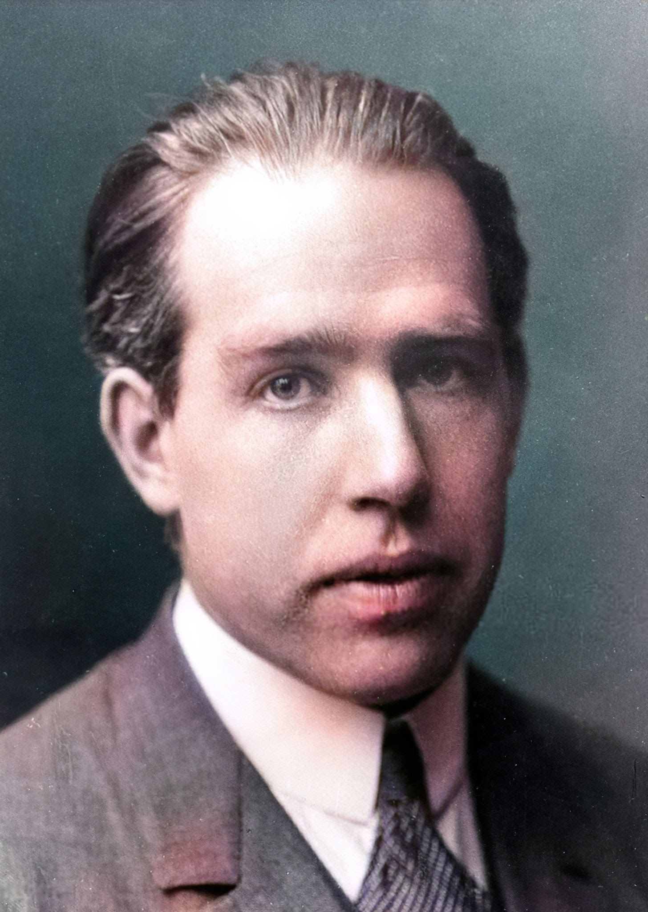
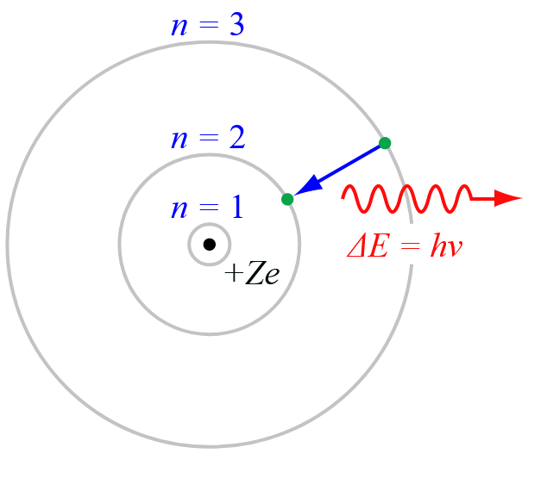
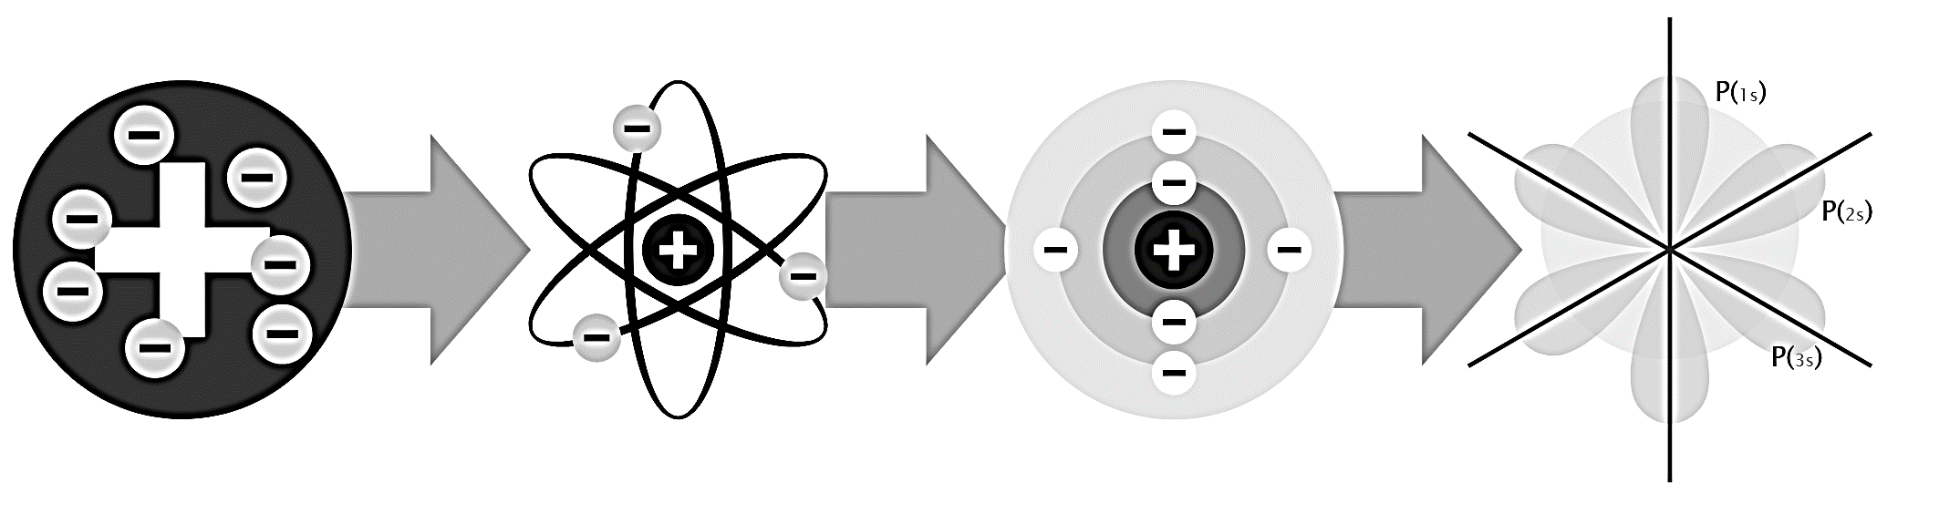
Niels Bohr
Born: October 7, 1885, Copenhagen, Denmark
Died: November 18, 1962, Copenhagen, Denmark

